Slide 1
ASP.NET Core fundamentals
Continuous staff improvement project
Serghei ADAm

Slide 2
Contents
• What is ASP.NET Core?
• Inspect Class Program, Startup.
• ASP.NET Core Middleware
• Add Logging feature provided by Middleware
• Creating components for middleware (Inline methods, classes)
• Static files

Slide 3
Available Technologies
ASP (ASP.NET, ASP.NET MVC, ASP.NET CORE MVC)
Go
Haskell
Node.js
PHP
Python
Ruby
J2EE - http://docs.oracle.com/javaee/1.4/tutorial/doc/
https://msdn.microsoft.com/en-us/library/bb470252(v=vs.100).aspx – Life cycle

Slide 4
ASP.NET CORE

Slide 5
ASP.NET Core
ASP.NET Core 1.0 was released on June 27, 2016
Runs starting from Visual Studio 2015 Update 3
ASP.NET Core 2.0 was released on August 14, 2017
Runs starting from Visual Studio 2017 15.3
Originally deemed ASP.NET vNext, the framework was going to be called ASP.NET 5 when ready. However, in order to avoid implying it is an update to the existing ASP.NET framework, Microsoft later changed the name to ASP.NET Core at the 1.0 release.

Slide 6
ASP.NET CORE
To be run and developed cross-platform
To have a modular architecture for easier maintenance
To be developed completely as open source software
To be applicable to current trends in web development, such as client-side applications and deploying to cloud environments

Slide 7
ASP.NET CORE BENEFITS
A unified story for building web UI and web APIs.
Architected for testability.
Razor Pages makes coding page-focused scenarios easier and more productive.
Ability to develop and run on Windows, macOS, and Linux.
Open-source and community-focused.
Integration of modern, client-side frameworks and development workflows.
A cloud-ready, environment-based configuration system.
Built-in dependency injection.
A lightweight, high-performance, and modular HTTP request pipeline.
Ability to host on IIS, Nginx, Apache, Docker, or self-host in your own process.
Side-by-side app versioning when targeting .NET Core.
Tooling that simplifies modern web development.

Slide 8
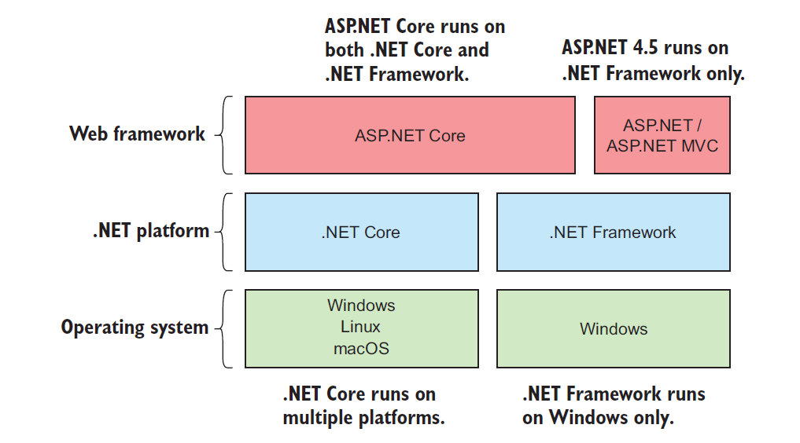
Cross-platform

Slide 9
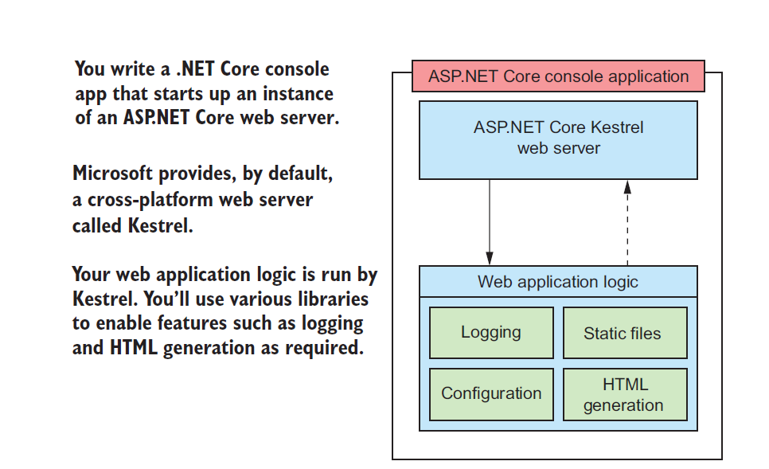
Cross-platform

Slide 10
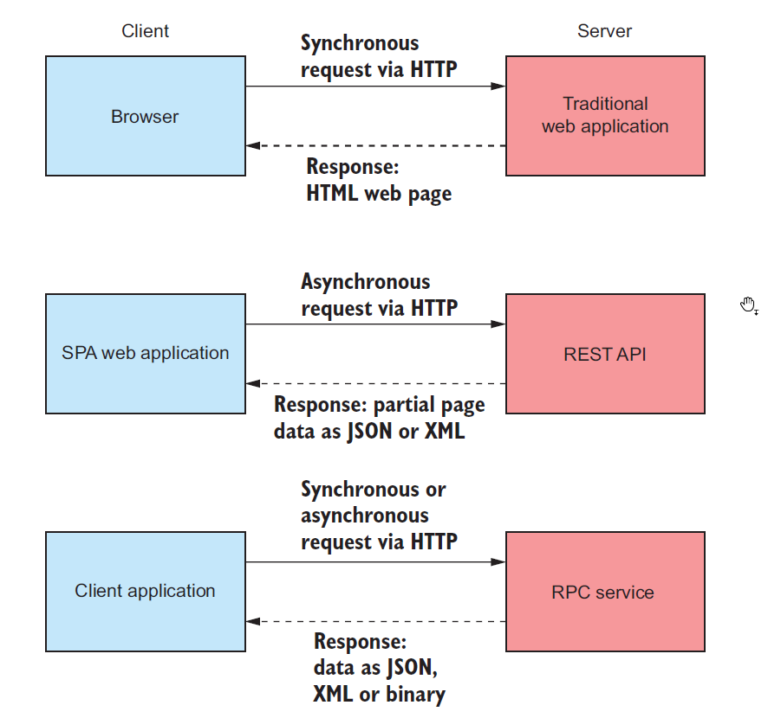
ASP.NET Core

Slide 11
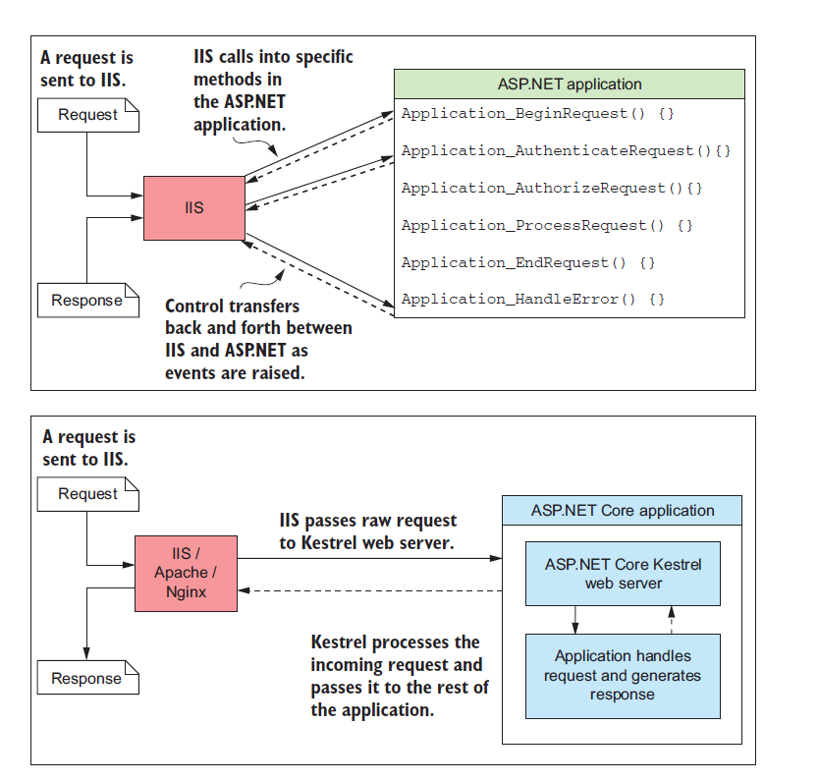
ASP.NET Core HOSTING MODELS
The difference between hosting models in ASP.NET (top) and ASP.NET Core (bottom).
With the previous version of ASP.NET, IIS is tightly coupled with the application.
The hosting model in ASP.NET Core is simpler;
IIS hands off the request to a self-hosted web server in the ASP.NET Core application and receives the response, but has no deeper knowledge of the application

Slide 12
ASP.NET CORE MODULARITY
Middleware “pipeline” for defining your application’s behavior
Built-in support for dependency injection
Combined UI (MVC) and API (Web API) infrastructure
Highly extensible configuration system
Scalable for cloud platforms by default using asynchronous programming

Slide 13
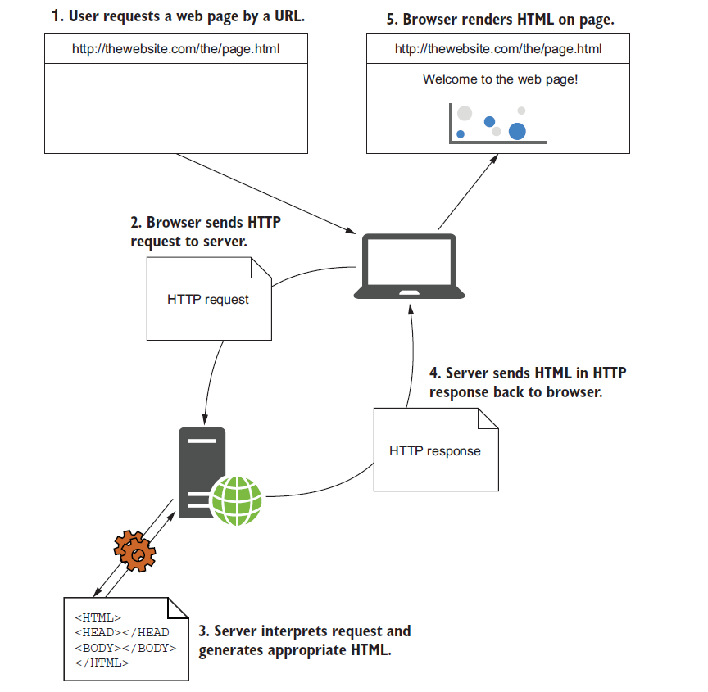
Requesting a web page

Slide 14
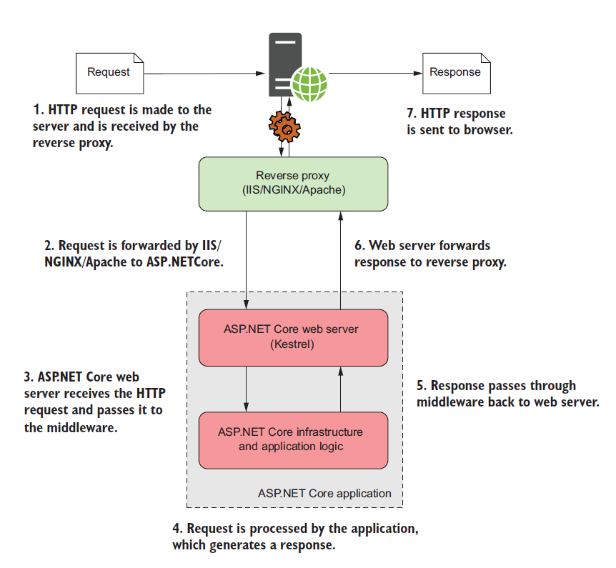
ASP.NET Core process a request

Slide 15
ASP.NET CORE. REVERSE Proxy
A reverse proxy is software responsible for receiving requests and forwarding them to the appropriate web server.
The reverse proxy is exposed directly to the internet, whereas the underlying web server is exposed only to the proxy.
This setup has several benefits, primarily security and performance for the web servers.

Slide 16
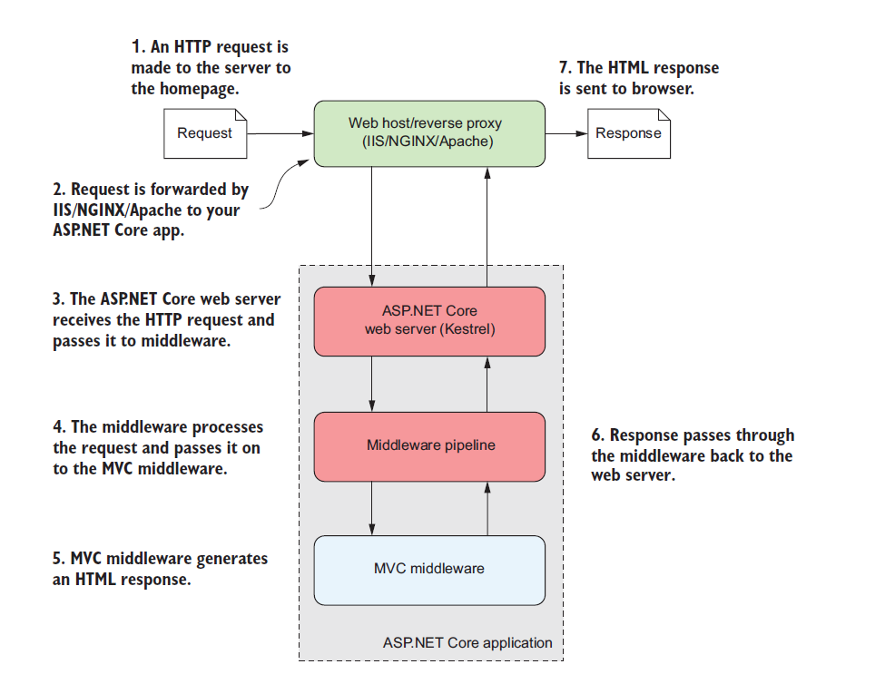
An overview of an ASP.NET Core application

Slide 17
KESTREL. HTTPContext.
The first port of call after the reverse proxy forwards a request is the ASP.NET Core web server, which is the default cross-platform Kestrel server. Kestrel takes the raw incoming request and uses it to generate an HttpContext object the rest of the application can use.
The HttpContext constructed by the ASP.NET Core web server is used by the application as a sort of storage box for a single request

Slide 18
KESTREL. HTTPCONTEXT
Kestrel is responsible for receiving the request data and constructing a C# representation of the request, but it doesn’t attempt to handle the request directly.
For that, Kestrel hands the HttpContext to the middleware pipeline found in every ASP.NET Core application. This is a series of components that processes the incoming request to perform common operations such as logging, handling exceptions, or serving static files.

Slide 19
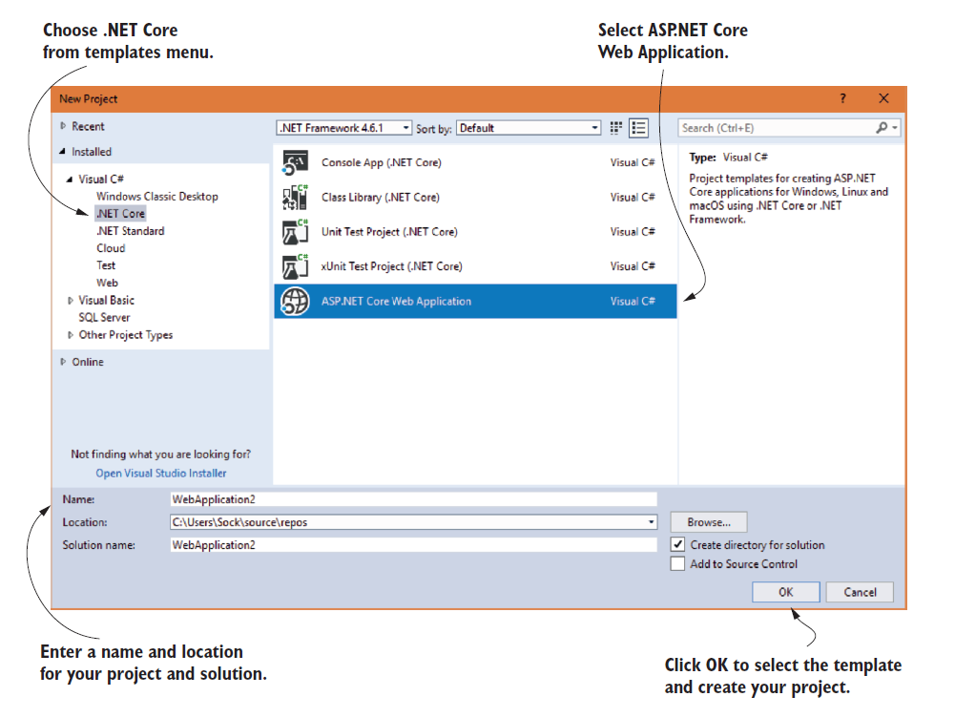
CREATE FIRST ASP.NET CORE APPlication

Slide 20
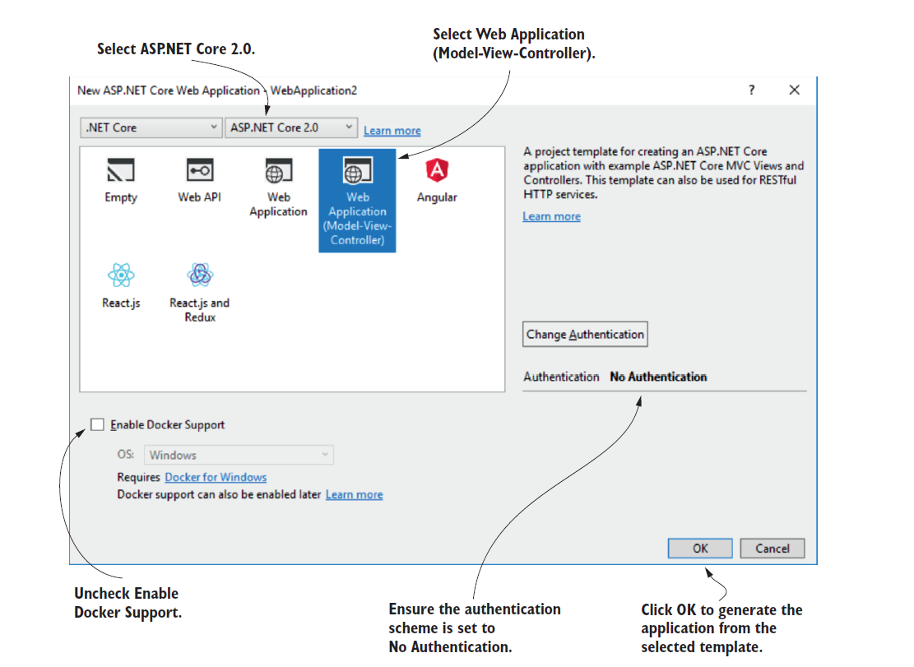
CREATE FIRST ASP.NET CORE APPlication

Slide 21
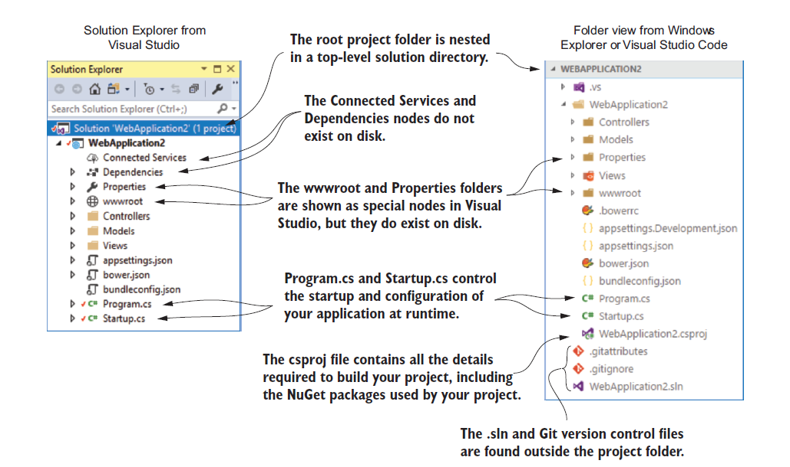
Understanding the project layout

Slide 22
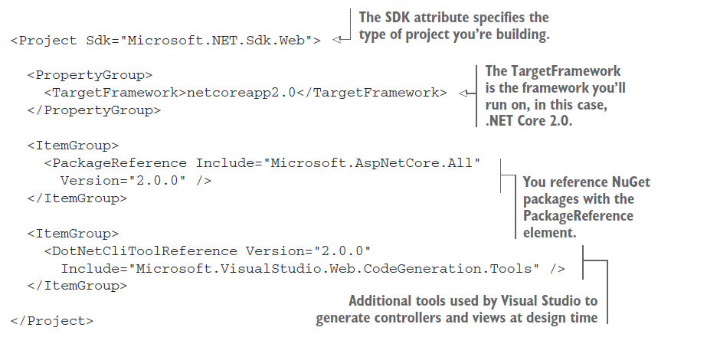
The csproj project file

Slide 23
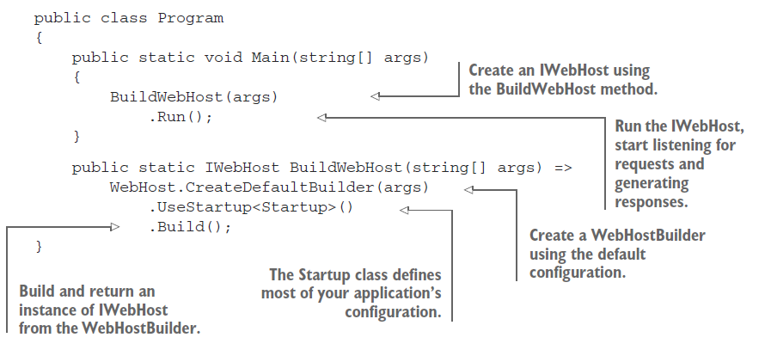
The Program class: building a web host

Slide 24
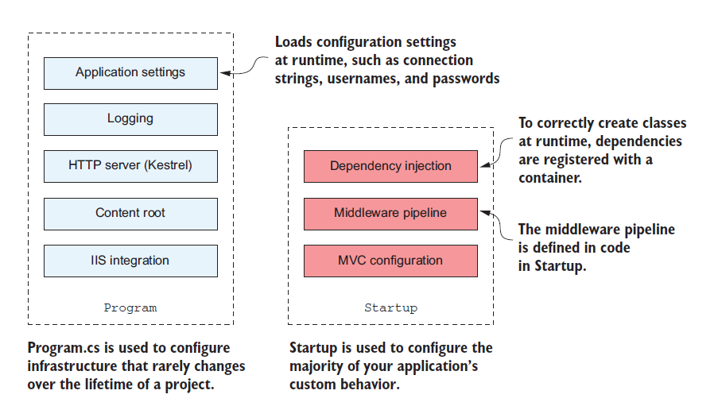
The difference in configuration scope for Program and Startup

Slide 25
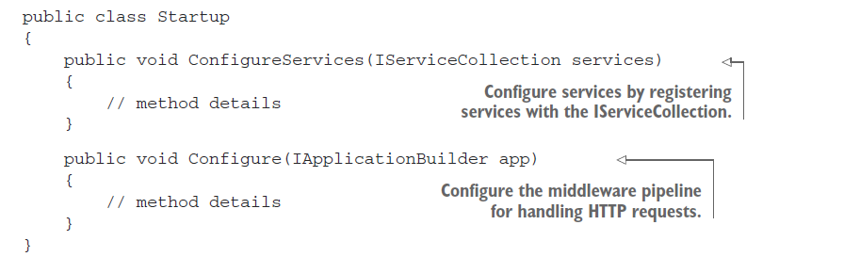
The Startup class: configuring your application
Service registration — Any classes that your application depends on for providing functionality—both those used by the framework and those specific to your application—must be registered so that they can be correctly instantiated at runtime.
Middleware and MVC — How your application handles and responds to requests

Slide 26
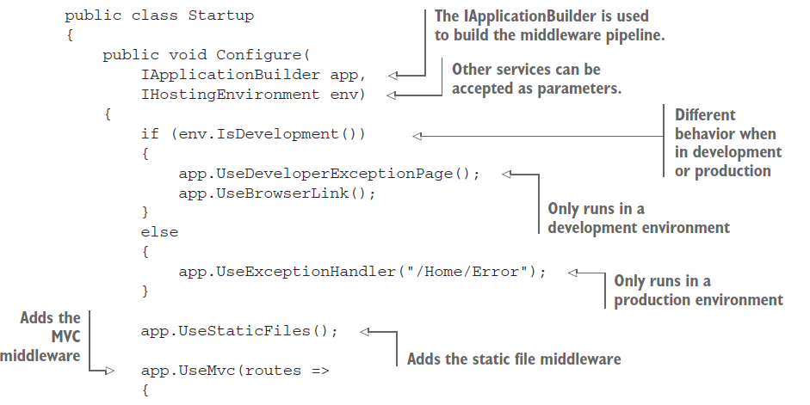
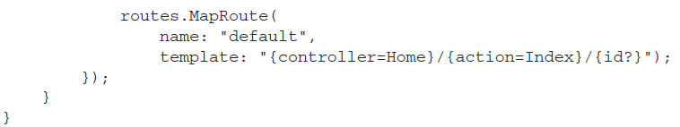
The Startup class: configuring your application

Slide 27
IHostingEnvironment
The IHostingEnvironment object contains details about the current environment,as determined by the WebHostBuilder in Program. It exposes a number of properties:
ContentRootPath—Location of the working directory for the app, typically the folder in which the application is running
WebRootPath—Location of the wwwroot folder that contains static files
EnvironmentName—Whether the current environment is a development or production environment
IHostingEnvironment is already set by the time Startup is invoked; you can’t change these values using the application settings in Startup. EnvironmentName is typically set externally by using an environment variable when your application starts.

Slide 28
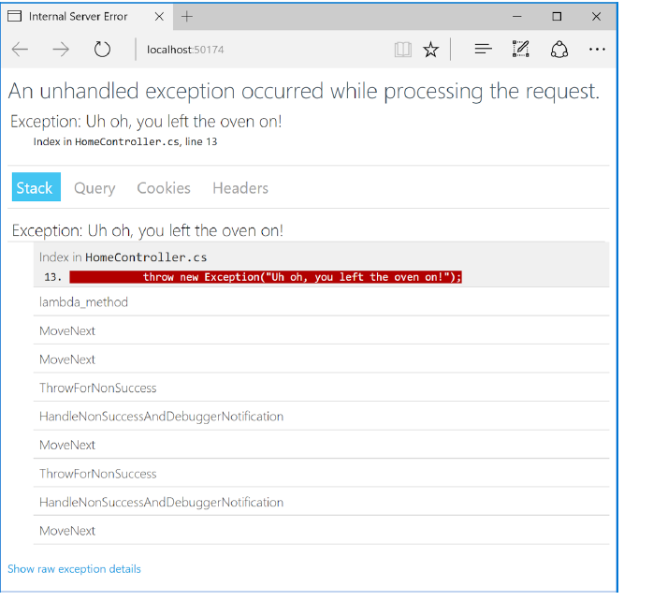
UseDeveloperExceptionPage
In development, DeveloperExceptionPageMiddleware (added by the UseDeveloperExceptionPage() call) ensures that, if your application throws an exception that isn’t caught, you’ll be presented with as much information as possible in the browser to diagnose the problem.

Slide 29
UseDeveloperExceptionPage
The developer exception page contains many different sources of information to help you diagnose a problem, including the exception stack trace and details about the request that generated the exception.
Running in a production environment, exposing this amount of data to users would be a big security risk. Instead, ExceptionHandlerMiddleware is registered so that, if users encounter an exception in your method, they will be presented with a friendly error page that doesn’t reveal the source of the problems

Slide 30

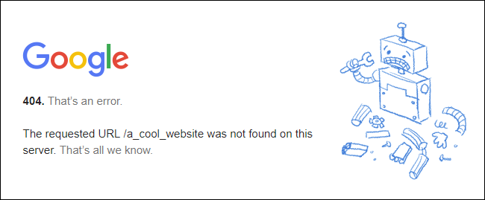

Slide 31
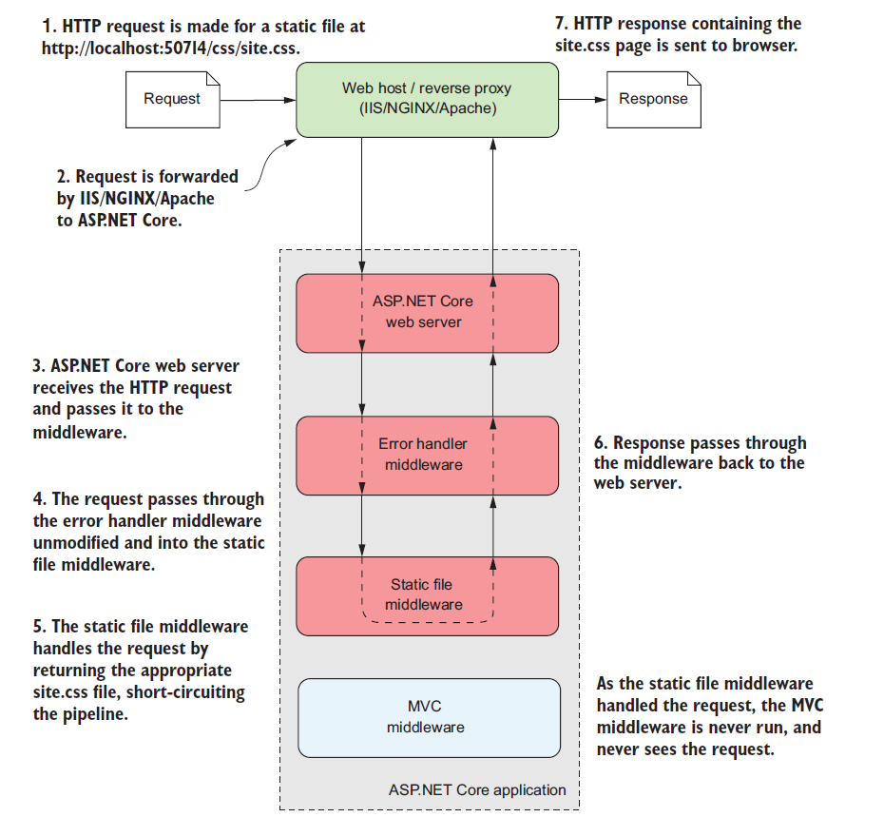
app.UseStaticFiles();

Slide 32
app.UseStaticFiles();
This middleware is responsible for handling requests for static files such as CSS files,JavaScript files, and images.
When a request arrives at the middleware, it checks to see if the request is for an existing file. If it is, then the middleware returns the file. If not, the request is ignored and the next piece of middleware can attempt to handle the request.
The request passes through the middleware pipeline until it’s handled by the static file middleware. This returns the requested CSS file as the response, which passes back to the web server. The MVC middleware is never invoked and never sees the request, if Static middleware returns the file.

Slide 33
MIDDLEWARe

Slide 34
MIDDLEWARE
In ASP.NET Core, middleware is C# classes that can handle an HTTP request or response. Middleware can
Handle an incoming HTTP request by generating an HTTP response.
Process an incoming HTTP request, modify it, and pass it on to another piece of middleware.
Process an outgoing HTTP response, modify it, and pass it on to either another piece of middleware, or the ASP.NET Core web server.

Slide 35
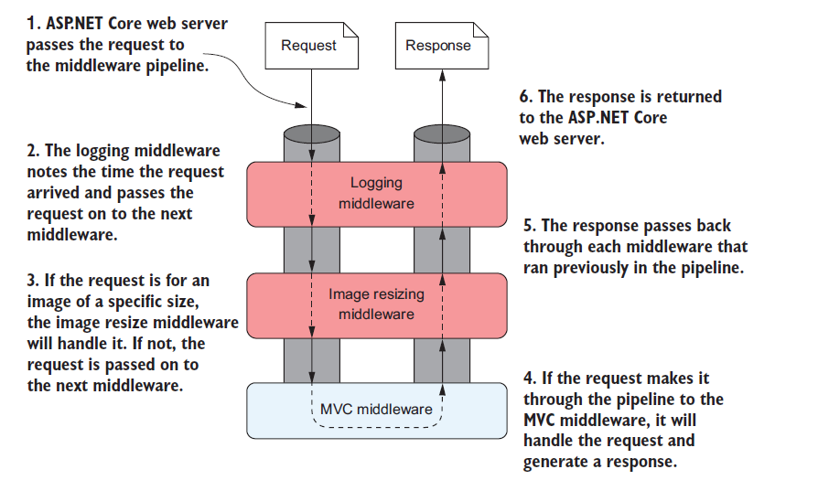
MIDDLEWARE

Slide 36
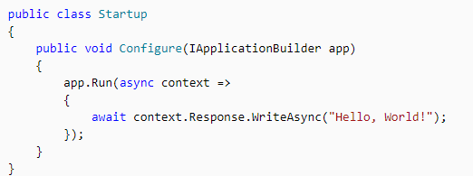
MIDDLEWARE
Simplest possible ASP.NET Core app sets up a single request delegate that handles all requests. This case doesn't include an actual request pipeline. Instead, a single anonymous function is called in response to every HTTP request.
The first Run delegate terminates the pipeline.

Slide 37
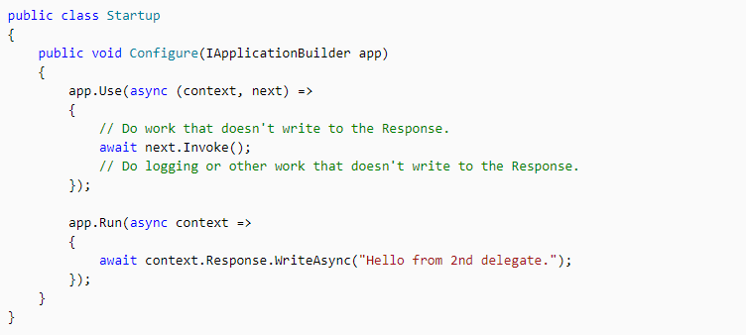
MIDDLEWARE
Chain multiple request delegates together with Use. The next parameter represents the next delegate in the pipeline. You can short-circuit the pipeline by not calling the next parameter. You can typically perform actions both before and after the next delegate, as the following example demonstrates:

Slide 38
MIDDLEWARE. ORDER.
The order that middleware components are added in the Startup.Configure method defines the order in which the middleware components are invoked on requests and the reverse order for the response. The order is critical for security, performance, and functionality.

Slide 39
MIDDLEWARE. ORDER.
Exception/error handling
HTTP Strict Transport Security Protocol
HTTPS redirection
Static file server
Cookie policy enforcement
Authentication
Session
MVC

Slide 40
MIDDLEWARE
Each middleware handles the request and passes it on to the next middleware in the pipeline.
After a middleware generates a response, it passes it back through the pipeline. When it reaches the ASP.NET Core web server, the response is sent to the user’s browser.
This arrangement, where a piece of middleware can call another piece of middleware, which in turn can call another, and so on, is referred to as a pipeline. You can think of each piece of middleware as a section of pipe—when you connect all the sections, a request flows through one piece and into the next.

Slide 41
MIDDLEWARE. PIPELINE
A key point to glean from this is that the pipeline is bidirectional. The request passes through the pipeline in one direction until a piece of middleware generates a response, at which point the response passes back through the pipeline, passing through each piece of middleware for a second time, until it gets back to the first piece of middleware.
Finally, this first/last piece of middleware will pass the response back to the ASP.NET Core web server.
All middleware has access to the HttpContext for a request. It can use this, for example, to determine whether the request contained any user credentials, which page the request was attempting to access, and to fetch any posted data. It can then use these details to determine how to handle the request.

Slide 42
MIDDLEWARE. Use, Run, and Map
Configure the HTTP pipeline using Use, Run, and Map. The Use method can short-circuit the pipeline (that is, if it doesn't call a next request delegate).
Run is a convention, and some middleware components may expose Run[Middleware] methods that run at the end of the pipeline.
Map extensions are used as a convention for branching the pipeline. Map* branches the request pipeline based on matches of the given request path. If the request path starts with the given path, the branch is executed.

Slide 43
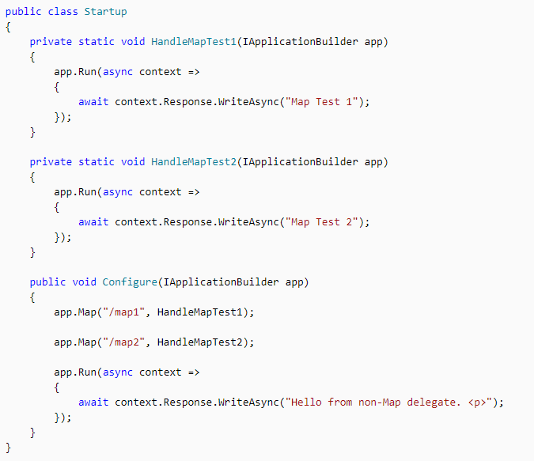
MIDDLEWARE. Use, Run, and Map

Slide 44
Building a custom middleware component
Custom middleware components don’t derive from a particular base class, but they have a certain shape
In particular, middleware classes should have a constructor that takes a RequestDelegate object, which represents the rest of the middleware pipeline, and they should have an Invoke function with a signature similar to
The Invoke() function is equivalent to the lambda function from the Use extension, and is called when a request is received

Slide 45
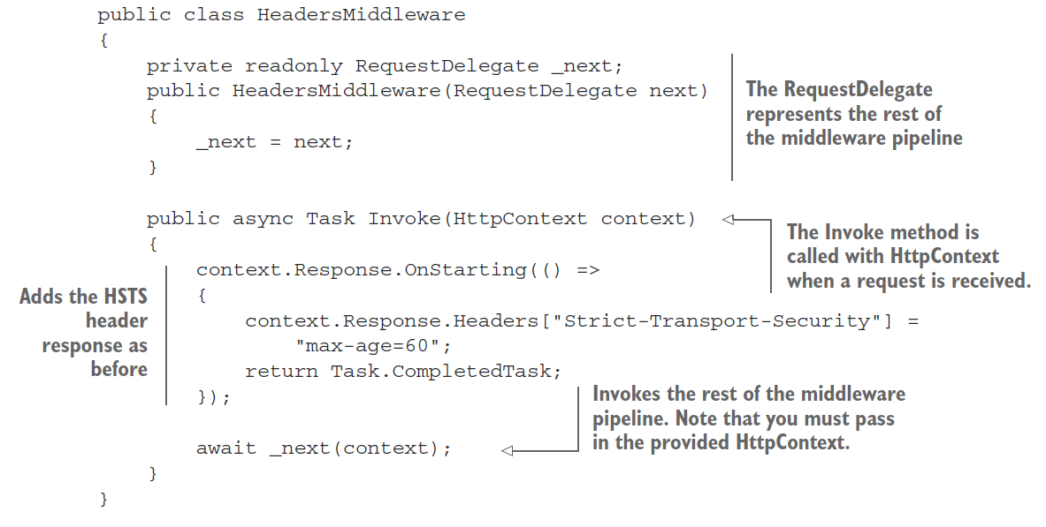
Building a custom middleware component

Slide 46
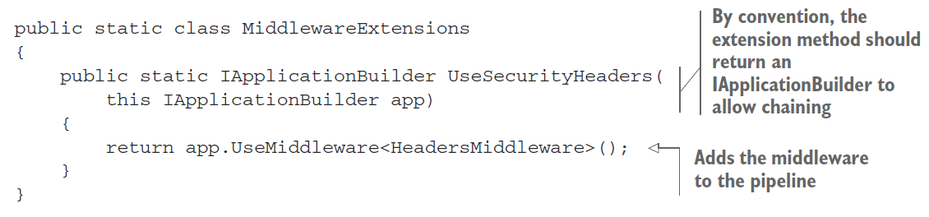

Building a custom middleware component
You can add this middleware to your app in Startup.Configure by calling
A common pattern is to create helper extension methods to make it easy to consume your extension method from Startup.Configure
With this extension method, you can now add the headers middleware to your app using

Slide 47
Logging in ASP.NET Core
ASP.NET Core supports a logging API that works with a variety of built-in and third-party logging providers.
A logging provider displays or stores logs. For example, the Console provider displays logs on the console, and the Azure Application Insights provider stores them in Azure Application Insights. Logs can be sent to multiple destinations by adding multiple providers.
To add a provider, call the provider's Add{provider name} extension method in Program.cs:

Slide 48
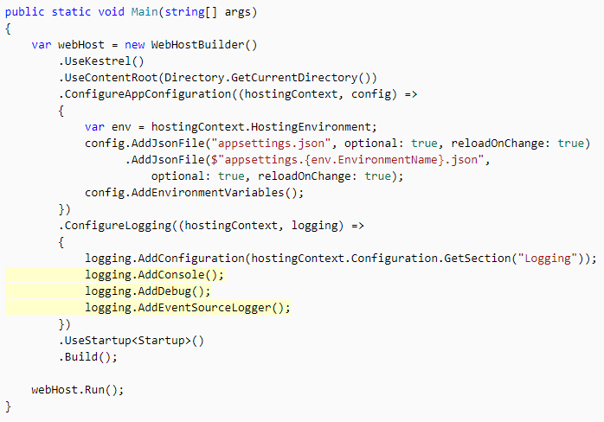
Logging in ASP.NET Core

Slide 49
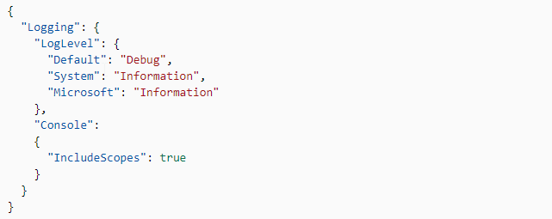
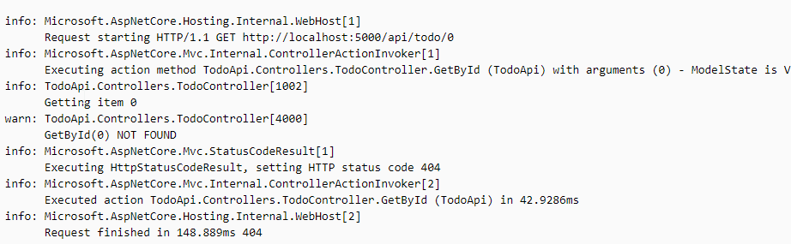
Logging. ConfiguratioN.
logging configuration is commonly provided by the Logging section of app settings files. The following example shows the contents of a typical appsettings.Development.json file:
Sample logging output

Slide 50
Assignment
Study and read about all mentioned concepts.
Create an ASP.NET Core web app and run it.
Install latest .NET Core SDK and relevant Runtime
Create custom middleware component.
Add Logging feature provided by middleware
Configure Kestrel

Slide 51
References
ASP.NET Core Middleware
Logging in ASP.NET Core
Kestrel web server implementation in ASP.NET Core
Lock A. – ASP.NET Core in Action. 2018

